Slide 1

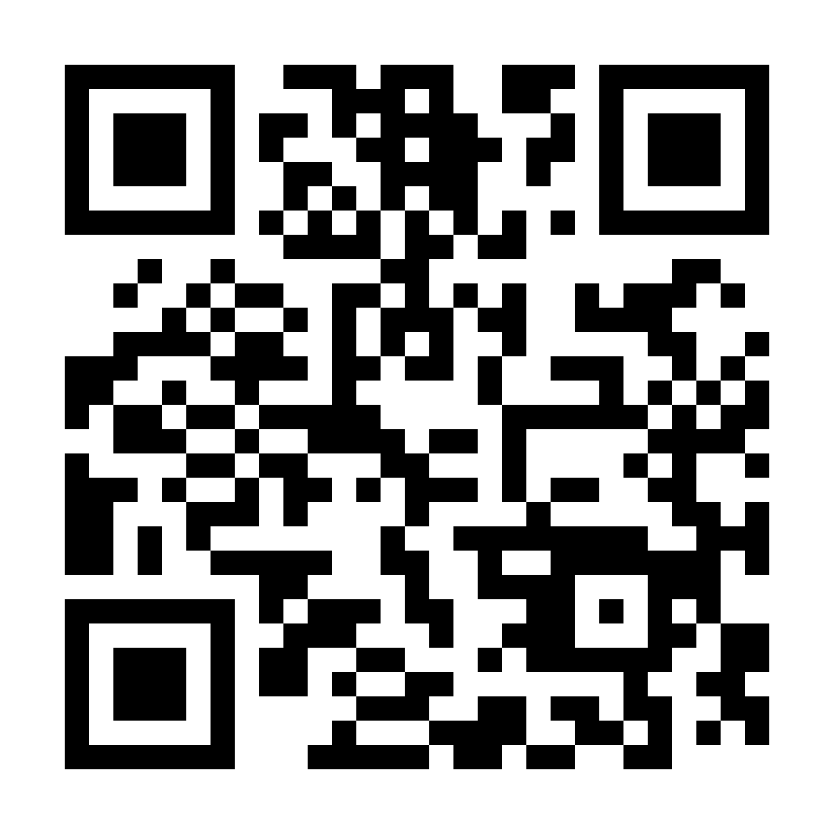
Help Us Give Back to Our Community!
Donation Drive on Behalf of AbleLight Thrift Shop
DATES: (ADD YOUR INFO HERE)
LOCATION: (ADD YOUR INFO HERE)
Bring your gently-used items such as:
Clothing & shoes
Books, toys, and games
Household items & décor
Accessories & seasonal items
*Note: AbleLight Thrift Shop is not accepting furniture donations.
Scan QR code to learn more about AbleLight Thrift Shop!

